Slide 1
AUTOMATIC MUSIC GENERATION
AIML Fundamentals with Cloud Computing and Gen AI (Capstone Project)
Name : DEVAPRASAD K M
NM-ID : au810021114314
E-mail : devakm2003@gmail.com
Guided By :P Raja ,( Master Trainer )

Slide 2

OUTLINE
Abstract of the project
Problem Statement
Proposed Solution
System architecture
GitHub Link
Project Demo(photos / videos)
Conclusion
Future Scope
References

Slide 3
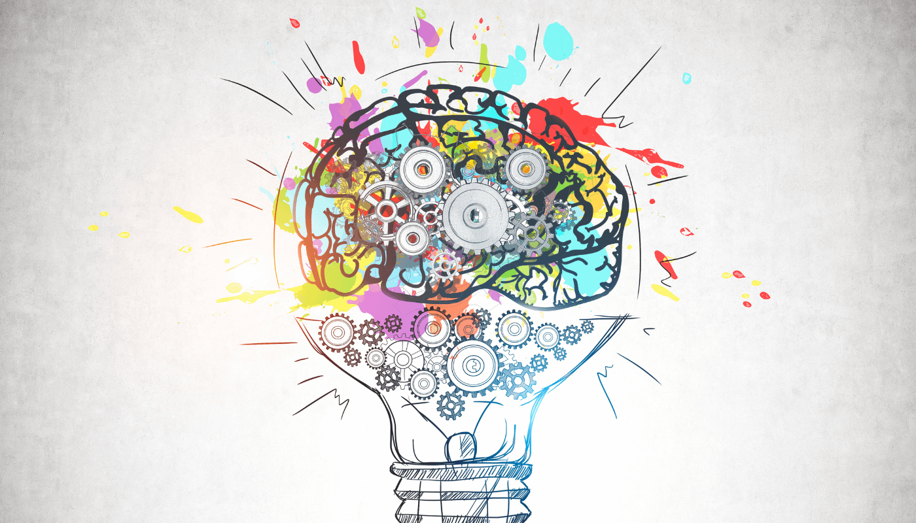
ABSTRACT
This project explores the development of an end-to-end model for automatic music generation, leveraging deep learning architectures, specifically WaveNet and Long Short-Term Memory (LSTM) networks. Automatic music generation synthesizes new music by learning patterns and structures from vast amounts of musical data. This study focuses on implementing WaveNet, known for its use of dilated causal convolutions to capture long-term dependencies in audio, from scratch using Keras. We compare WaveNet's performance to that of an LSTM-based model, analyzing the strengths and limitations of each in handling sequential music data.
A comprehensive dataset of musical sequences, preprocessed for model training, enables the models to generalize effectively. Training the models involves techniques like hyperparameter tuning and data augmentation to enhance the generated music’s quality. Evaluation metrics include training time, loss, and subjective audio quality, with WaveNet often excelling in temporal dependencies, while LSTM provides faster training times. Key challenges such as data scarcity and overfitting are addressed to improve model robustness. Findings indicate that both architectures have potential in music generation, with WaveNet producing richer sequences. Future work could explore enhancements in model complexity and dataset diversity to refine the generated music’s quality.

Slide 4

Problem Statement
The project aims to develop an automated system for music generation, using deep learning models to generate coherent and creative musical sequences. Traditional music composition requires significant skill and creativity, but with advancements in AI, there is potential to create music autonomously. This project investigates the use of WaveNet and LSTM architectures, which are effective in handling sequential data, to model and generate music patterns. The challenge lies in training these models to learn complex temporal dependencies within music data, while ensuring they generalize well to create diverse and appealing compositions. Key objectives include implementing WaveNet from scratch using Keras, comparing its performance against LSTM, and exploring the impact of dataset size on the quality of generated music. The ultimate goal is to identify the architecture best suited for high-quality, automated music generation.

Slide 5
Proposed Solution
To address the problem of automatic music generation, this project develops and compares two deep learning architectures: WaveNet and Long Short-Term Memory (LSTM) networks. WaveNet is implemented from scratch using Keras, incorporating dilated causal convolutions to capture intricate temporal dependencies within musical sequences, which are essential for producing coherent and creative compositions. Simultaneously, an LSTM-based model is built, leveraging its gated structure to retain long-term dependencies in music data, making it a viable alternative for sequence generation tasks. A large and diverse dataset of musical sequences is collected, cleaned, and preprocessed to optimize the training process, as data quality and quantity are crucial for model generalization.
The models are then trained using advanced techniques such as hyperparameter tuning and data augmentation to maximize the quality of generated music. Evaluation metrics include training time, loss, and subjective audio quality, allowing a comprehensive comparison of the strengths and weaknesses of both architectures. WaveNet is anticipated to excel in capturing the nuances of musical patterns, while LSTM may offer faster training times. Through this comparison, the project aims to identify the model best suited for high-quality, autonomous music generation, offering insights into the effectiveness of each architecture for creative AI applications.

Slide 6
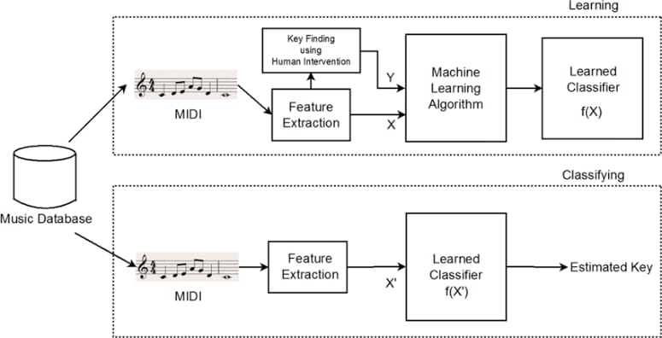
System architecture
Step-by-Step Process:
Data
Model Design
Training
Evaluation
Music Generation

Slide 7
Data Collection & Preprocessing: Collecting a large, diverse dataset and preparing it for model training.
Model Design: Implementing WaveNet and LSTM architectures suited for sequence modeling.
Training Pipeline: Optimizing model parameters for effective music generation.
Evaluation: Comparing WaveNet and LSTM on performance metrics like loss, training time, and generated audio quality.
Music Generation & Output: Synthesizing new music sequences based on learned patterns.

Slide 8
GitHub Link
https://github.com/Deva4314/au810021114314-Devaprasad-k-m-Automatic-music-generator-

Slide 9
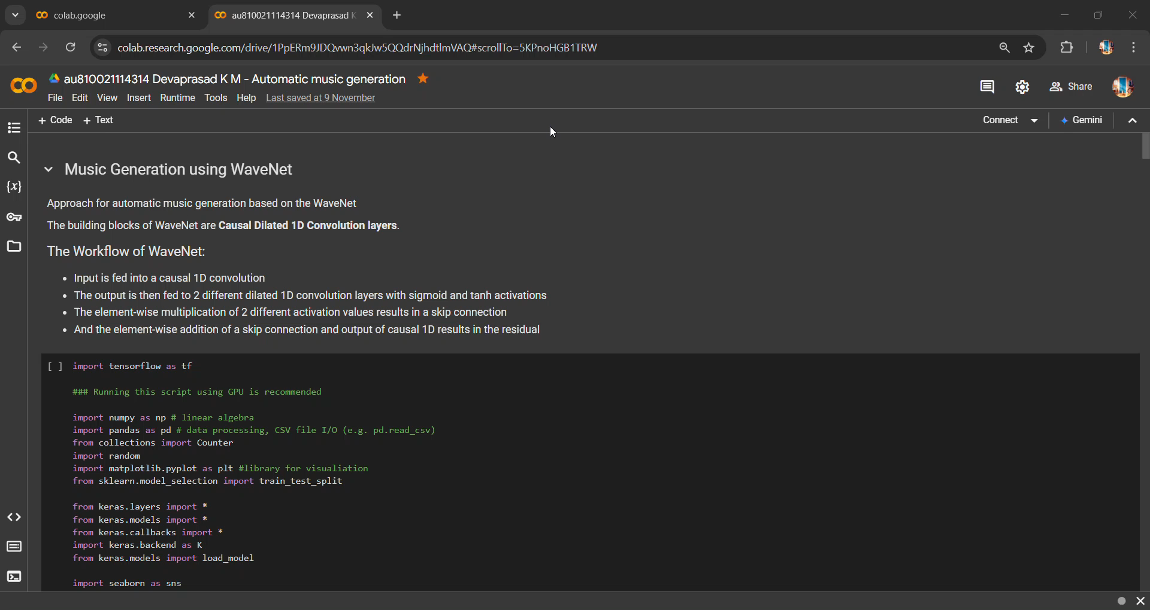
Project Demo(Recorded Video)

Slide 10
Conclusion
This project successfully demonstrates the potential of deep learning for automatic music generation, comparing the WaveNet and LSTM architectures to understand their effectiveness in creating high-quality musical sequences. WaveNet, with its dilated causal convolutions, shows strengths in capturing complex musical patterns, producing rich and coherent sequences, while LSTM provides faster training times with efficient handling of sequential data. Through careful model design, large dataset collection, and optimized training, both models generated music with unique qualities. Key findings highlight the importance of dataset size and architecture choice for model generalization. Future directions could involve exploring more advanced architectures or incorporating additional musical features to further enhance music generation quality. The project underscores the promise of AI in creative domains and sets a foundation for further advancements in automated music composition.

Slide 11
Future Scope
The project opens several pathways for advancing automatic music generation. Future work could explore more sophisticated architectures, such as Transformer models, which are known for their attention mechanisms and potential to capture even more complex musical dependencies. Expanding the dataset to include diverse genres and cultural music styles could improve the model’s ability to generalize across different musical forms. Additionally, incorporating other musical elements, like dynamics and harmonics, could enrich the generated compositions. Real-time music generation for interactive applications, such as virtual instruments or personalized playlists, is another promising area. Finally, fine-tuning models for specific genres or user preferences could make AI-generated music more adaptable and relevant to various audiences and applications.

Slide 12
References
Project Github link,P Raja , 2024
Project video recorded link (youtube/github), P Raja, 2024
Project PPT & Report github link, P Raja , 2024

Slide 13
THANK YOU

